Slide 1
D Level Horse Management
Record Keeping and Conformation

Slide 2
Record Keeping
Why keep records?
To track health
To aid in communication between carers
To have important information in one place
To keep horse health up to date
To notice when things aren’t right
What do you need to record?
Horse information
Rider Information
Feed routine
Health records
Foot care
Training schedule
Resting TPR
De worming

Slide 3
Signs of good health
Clear, bright eyes, nose mouth (mucus membranes)
Free from odor
Normal Feces
Alert
Eating and drinking
Weight bearing on all four legs

Slide 4
When to call the vet
When a horse is showing signs of distress.
Restless
Not eating, drinking
Colic
Lame

Slide 5
Current Rating
Amy- unrated Sue- unrated Heather- unrated Vilma- unrated
Laeken- D2 HM, D2 EV1 Birdy- D2HM, D2 EV1 Brenna- D2HM D2EV1
Aly- D2 HM, D1 RD Maisy- D2 HM, D2 EV1 Sarah- D2 HM, D1 RD
Tinley- D1 HM Delaney- Unrated Freya- Unrated

Slide 6
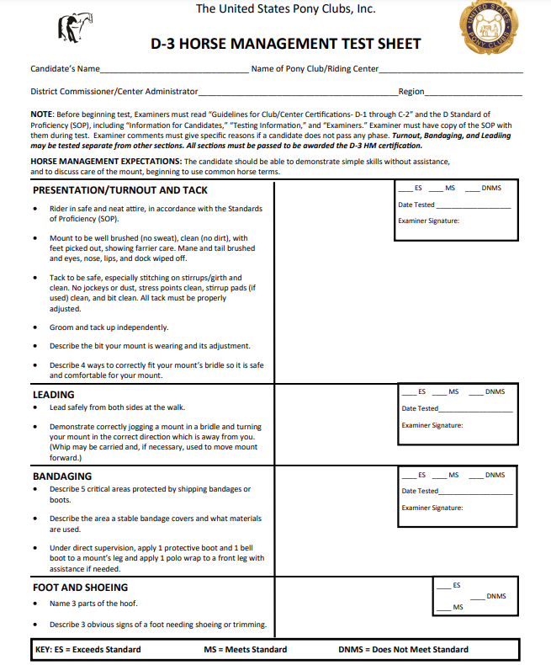
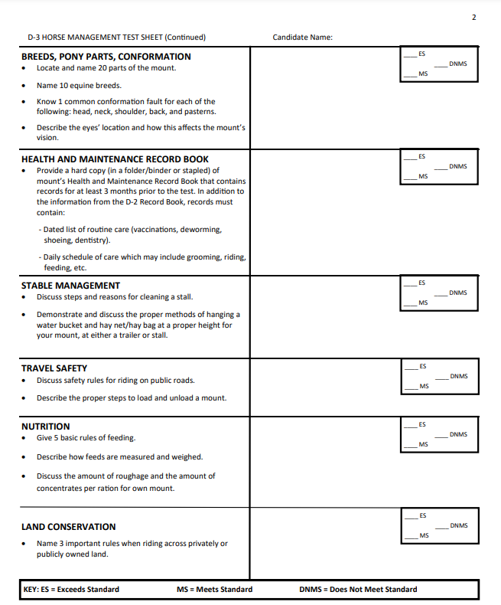
Rating up- Horse Management

Slide 7
Horse Assignment and Communication
A notice board with weekly updates
Amy- Pango Sue- Glen/Peaches Heather- Flo Vilma- Cosmos
Laeken- Bling Birdy- Angel Brenna- Merrylegs Aly- Lochlan
Maisy- Nova Sarah- Chili
Fill out the record book weekly for at least 3 months.

Slide 8
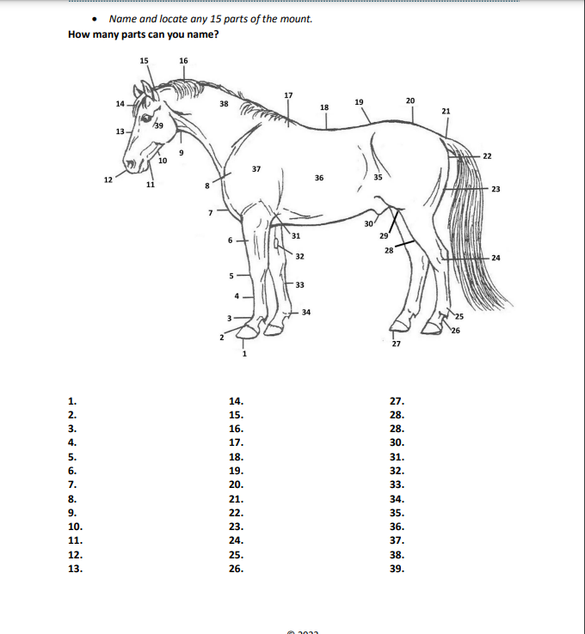
Parts of the Horse -
D2- Name and locate 10
D3- Name and locate 15
Notes:
km

Slide 9
Conformation
What is Conformation?
The way in which a horse’s body is ‘put together’
Why is conformation important?
It affects the horses ‘way of going’ and it’s suitability for certain disciplines. Conformation is a huge factor in the horses ability to remain sound.
What is ‘Good’ Conformation?
A horse that appears to be proportional and balanced throughout its body composition is desirable.

Slide 10
Assessing Conformation
Skeletal Structure
This cannot be changed and describes the lengths of certain parts of the body and how the skeleton is attached.
Muscle tone
This can be altered through nutrition and exercise and describes how the muscle is built and lays across the body.
Angles
The angles in which the attach, some of these can be manipulated and slightly altered.

Slide 11
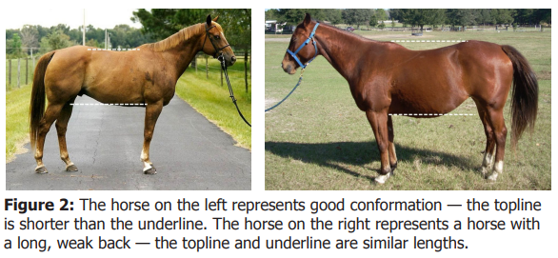
Skeletal Structure.
What is desirable?
Medium length body parts - Back, cannon, pastern, neck
Neck, back and hip all similar length
Medium sized withers
Topline shorter than under belly
Point of wither and croup level
Same sized feet
Shorter hip allows for more rear power- allowing the horse to step under.
What is not desirable?
A long back- weak and become sway- hard to fit saddles
Long cannons- weak
Long pasterns- allow for smoother gaits, but are weak and vulnerable to injury
Low withers- saddle slip up
High withers- saddles hard to fit

Slide 12
Muscle coverage
What is desirable?
A deep ‘V’ in the chest
Gaskin and forearm to be long and smooth
Back should tie in smoothly to the hip
Topline should be smooth and seamless
Stifle widest part when viewing from behind
Smooth and even across the whole body
What is not desirable?
Bunching or knots in the muscle
Uneven muscle coverage
Weak/indented muscling

Slide 13
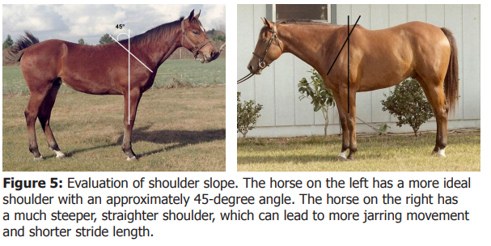
Important Angles
What should I look for?
The slope of the should
The angle of the hip
The hoof - pastern angle
It is desirable for all of these angles to be approximately 45 degrees. A steeper angle makes for a choppy gait.
Larger slopes/angles allow for a smoother gait, but weaker area.

Slide 14
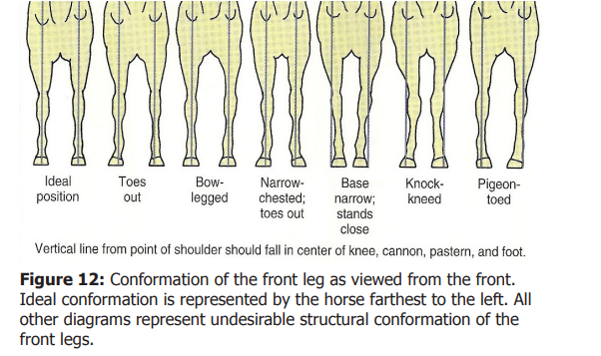
Leg positioning- Draw a straight line from top to bottom

Slide 15
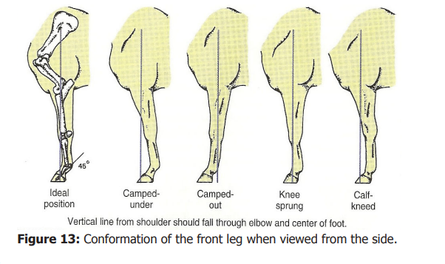
Leg positioning

Slide 16
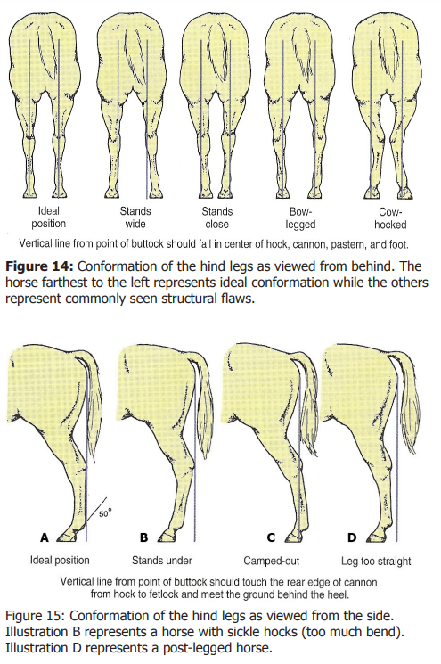
Leg positioning

Slide 17
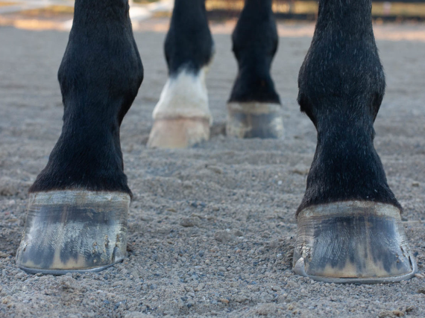
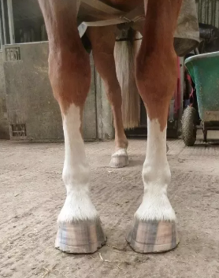
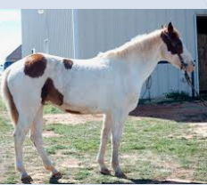
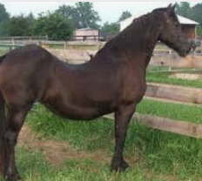
Common Faults
Some common conformational faults
Club foot- one foot larger than the other
Pigeon toed - toes turn in
Sway back- a long back that ‘sags’
Bull neck - short thick neck- hard to balance

